Slide 1
AREC 213: Lecture 3
Lecture 3: Products and Feasibility
Notes:
https://www.youtube.com/watch?v=xEuzcsc0ngs

Slide 2
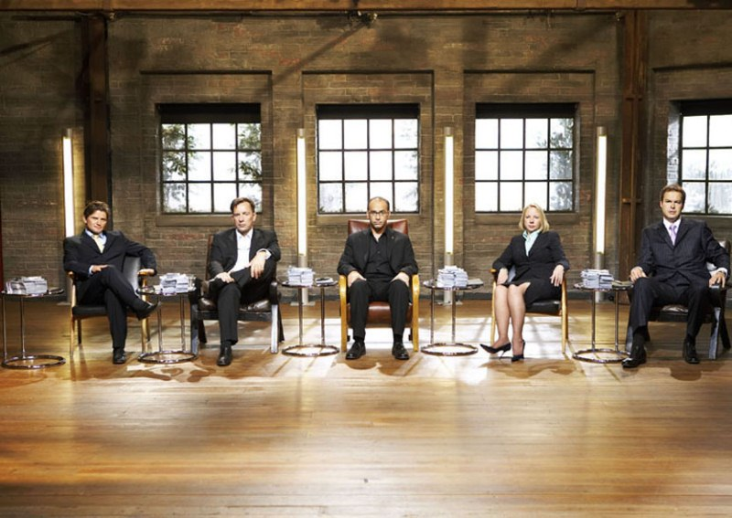
AREC 213: Lecture 3
Dragons Den Episode ()
Dragons Den (UK)
Notes:
Pitch at 29 minutes

